Slide 1

RESEARCH READOUT AND DISCUSSION
Adding preferred name, pronouns, gender identity, and sexual orientation to VA.gov
Friday, January 21, 2022

Slide 2
What we’ll cover
OVERVIEW
Who we are
What is the VA.gov profile?
Research overview
Findings & recommendations
Discussion

Slide 3
Who we are

Slide 4
Meet our team
WHO WE ARE
Samara Strauss: VA.gov profile team lead
Marci McGuire: Profile team PM
Christina Gednalske: Profile designer and researcher
Liz Lantz: Profile designer and researcher
Adam Whitlock: Profile frontend developer

Slide 5
The VA.gov Profile

Slide 6
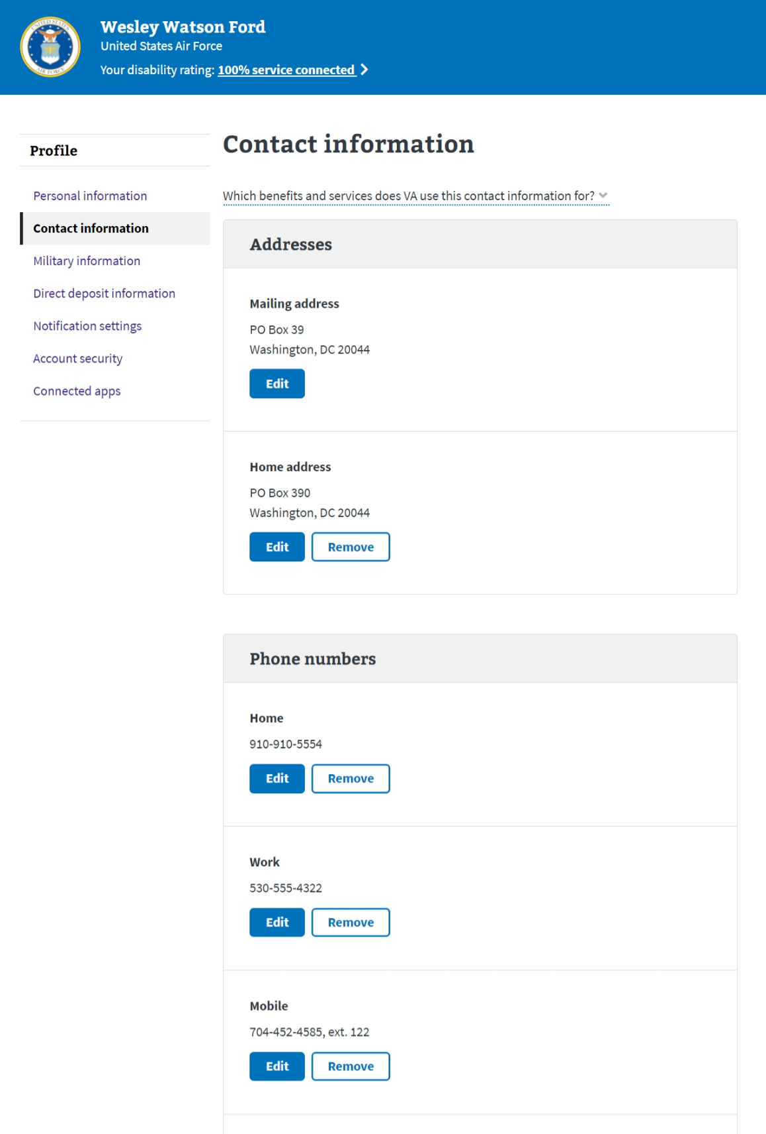
Overview
The va.gov profile
The VA.gov profile allows Veterans and other non-Veteran VA.gov users to view and update what the VA knows about them.

Slide 7
Profile features
THE VA.GOV PROFILE
Currently, Veterans can do the following from the VA.gov profile:
View their personal information*
Update their contact information*
View their military history
Update their direct deposit information
Set notification preferences*
Manage third-party applications connect to their VA.gov accounts
* Indicates features available to non-Veteran users

Slide 8
Who can have a VA.gov profile
THE VA.GOV PROFILE
Veterans who receive health care
Veterans who do not receive health care
Service members
Family & dependents
Caregivers
Employees
…and anyone with any relationship to the VA

Slide 9
Takeaways
THE VA.GOV PROFILE
Given the many audiences the profile serves, systems we connect to, and many benefits we support, we consider the VA.gov profile to be an administrative tool; it is not a medical record and does not exclusively support health-related records.
As such, our recommendations consider this important difference.

Slide 10
Research overview

Slide 11
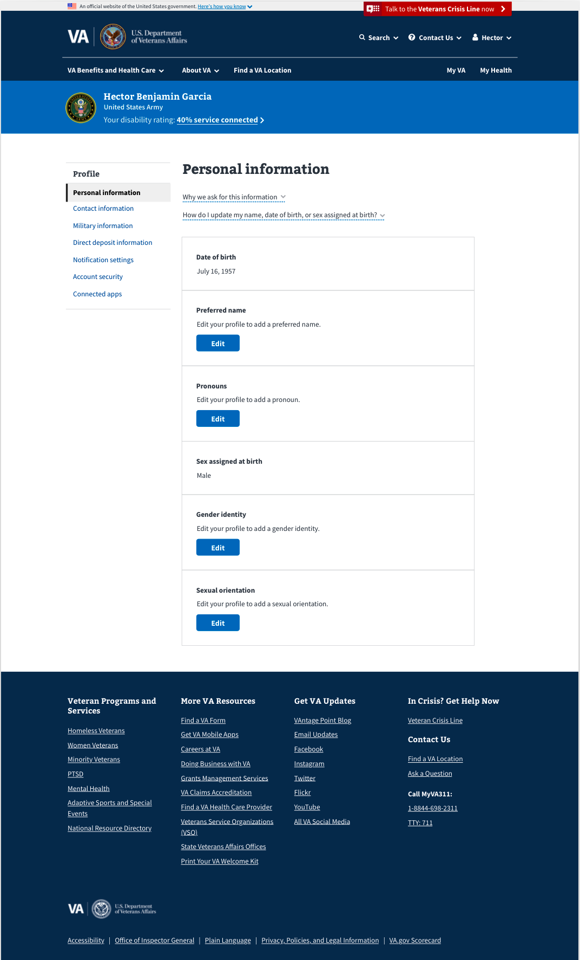
Methods
RESEARCH OVERVIEW
We conducted remote, moderated interviews via Zoom. We showed participants a high-fidelity prototype and discussed each new field.
We spoke with 5 Veterans. 2 participants identified as gay and/or transgender.

Slide 12
Research goals
Research overview
Evaluate whether Veterans understand what this information is and why we are asking for it.
Evaluate whether Veterans understand the terminology used in the Personal Information section as it pertains to updating or changing their preferences.
Validate that the order of information makes sense to Veterans.

Slide 13
Consulting with authoritative sources
RESEARCH OVERVIEW
We also consulted Amy Paris, who is our colleague through the United States Digital Service and works on behalf of the following groups:
The USDS SOGI Data Discovery Sprint (Feb-Mar 2021) – Team Lead.
The White House Equitable Data Working Group (EDWG), Sub-Group on Demographic Data Collection in Administrative Forms and Benefits Applications (ongoing work) – Chairperson.
The White House Interagency Policy Committee on Gender Markers – Co-Chairperson.

Slide 14
Findings & recommendations

Slide 15
Veterans are not confident their personal information will be used for their benefit.
FINDING #1

Slide 16
Veterans are not confident their personal information will be used for their benefit.
FINDING #1
Participants shared concerns that this information could be used to the Veteran’s disadvantage, including that Veterans could be judged and treated differently by VA staff.
Participants shared concerns about alienating Veterans and believe more conservative Veterans would find some or all of the content objectionable.
Participants' general perception was that the VA is gathering this information for demographic purposes and/or healthcare, but they are not sure the information will be used for good.

Slide 17
Sex assigned at birth and sexual orientation is triggering to Veterans who identify as other than straight or cisgender.
FINDING #2

Slide 18
Sex assigned at birth is triggering to Veterans who identify as other than straight or cisgender.
FINDING #2
The participants identifying as gay or transgender expressed concern for the inclusion of sex assigned at birth and sexual orientation.
A transgender participant conveyed that forcing transgender folks to see sex assigned at birth in their profile is traumatic. This participant also conveyed his own experiences facing medical discrimination due to related information.
A gay participant conveyed his and his friends’ experiences of sexual orientation information being used in harmful ways and clarified that not only would he not fill out the information, but he would complain to the VA if it were listed on his profile.

Slide 19
“I don’t really understand why you would put sexual orientation other than data collection when Trump came up with taking the surgeries away and health professionals can refuse rights. There has been a debate about medical care and if you put your sexual orientation, you will have biased doctors. They may not provide the care needed.”
-Participant #8

Slide 20
“I’m gay. So if someone sees that in my profile, they’re automatically going to get a thought in their head and assume something.”
-Participant #3

Slide 21
“There's a very real possibility that someone in the VA system would see that and automatically take up arms against them. They could do something detrimental to that person without that person realizing it. But you know, it's caused a ripple effect down to where it does hurt that person.”
-Participant #3

Slide 22
“Again, I don’t know why the VA needs that, but there's probably a reason for it.”
-Participant #6

Slide 23
“Sex assigned at birth -- I don't understand why that's there. That brings up a whole different bag of worms for people who are transgender.”
-Participant #8

Slide 24
“I would call someone at VA and complain [if I saw sexual orientation in my own profile].”
-Participant #3

Slide 25
Guidance from Amy Paris
FINDINGs #1 & #2
While a person's sexual orientation and sex assigned at birth might be relevant in a clinical health setting, they are not clearly relevant as administrative metrics.
The key difference between the VA.gov profile and anything on the VHA side of things is that we are dealing with Class 2 (administrative) SOGI data, and VHA is dealing with Class 4 (medical) SOGI data.

Slide 26
Recommendations
FINDINGS #1 & #2
As such, we recommend that VA.gov not show or collect the following:
Sex assigned at birth
Sexual orientation
Whether someone identifies as transgender or not (note: we would still include the gender identity field without the “transgender” options)

Slide 27
Recommendations
FINDINGS #1 & #2
We understand that VHA will still collect and store this information, and we are not making any recommendations on how this information is handled from a health perspective.
However, we want to be sensitive to the fact that this information is not only not necessary for an administrative tool like VA.gov, but that there is the potential for this information be used to harm Veterans if it falls into the wrong hands via our platform. We trust that this information will be treated with the proper sensitivity and protection via the health system.

Slide 28
Participants wanted to see a write-in option for gender identity.
FINDING #3

Slide 29
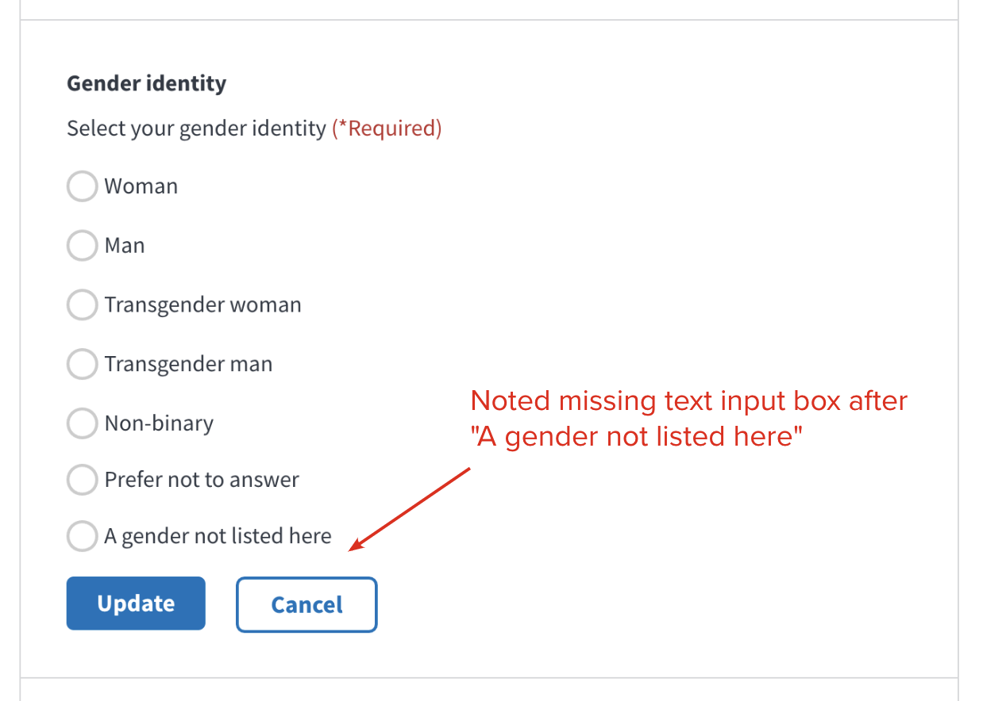
Participants wanted to see a write-in option for gender identity.
Finding #3
Participants noted that they would expect a text input field for additional options in Gender identity that matches those offered in other fields.
Check-in: Is an open-text option getting added to MPI?

Slide 30
Discussion

